Slide 1
Decrease and Conquer

Slide 2
Decrease and Conquer
“Decrease and Conquer is based on exploiting the relationship between a solution to a given problem instance of a problem and a solution to a smaller instance.”
Decrease by a Constant
Decrease by a Constant Factor
Variable Size Decrease

Slide 3
Decrease by a Constant
Each iteration size of instance is reduced by same constant (often 1).
An example you have seen of a “Decrease by a Constant” algorithm?

Slide 4
Decrease by a Constant Factor
Each iteration size of instance is reduced by same constant factor (often ½).
Uncommon but very efficient.
An example you have seen of a “Decrease by a Constant Factor” algorithm?

Slide 5
Variable Size Decrease
Size reduction varies from iteration to iteration of the problem.
An example you have seen of a “Variable Size Decrease” algorithm?

Slide 6
Decrease-by-One Algorithms

Slide 7
Sorting

Slide 8
Insertion Sort
If sorting an array of n items, A[0…n-1], imagine that first n-1 items have been sorted, A[0…n-2].
How do we get a solution to the original problem from solution to smaller problem?
29 | 34 | 45 | 68 | 89 | 90 | 17

Slide 9
Insertion Sort
InsertionSort(A[0...n-1])
for i ← 1 to n-1 do
v ← A[i]
j ← i – 1
while j ≥ 0 and A[j] > v do
A[j+1] ← A[j]
j ← j-1
A[j+1] ← v
How would insertion sort work on … ?
89 | 45 | 68 | 90 | 29 | 34 | 17

Slide 10
Insertion Sort
89 | 45 | 68 | 90 | 29 | 34 | 17
45 | 89 | 68 | 90 | 29 | 34 | 17
45 | 68 | 89 | 90 | 29 | 34 | 17
45 | 68 | 89 | 90 | 29 | 34 | 17
29 | 45 | 68 | 89 | 90 | 34 | 17
29 | 34 | 45 | 68 | 89 | 90 | 17
17 | 29 | 34 | 45 | 68 | 89 | 90

Slide 11
Insertion Sort Efficiency
InsertionSort(A[0...n-1])
for i ← 1 to n-1 do
v ← A[i]
j ← i – 1
while j ≥ 0 and A[j] > v do
A[j+1] ← A[j]
j ← j-1
A[j+1] ← v
Basic Operation? Summation? Big-Θ?

Slide 12
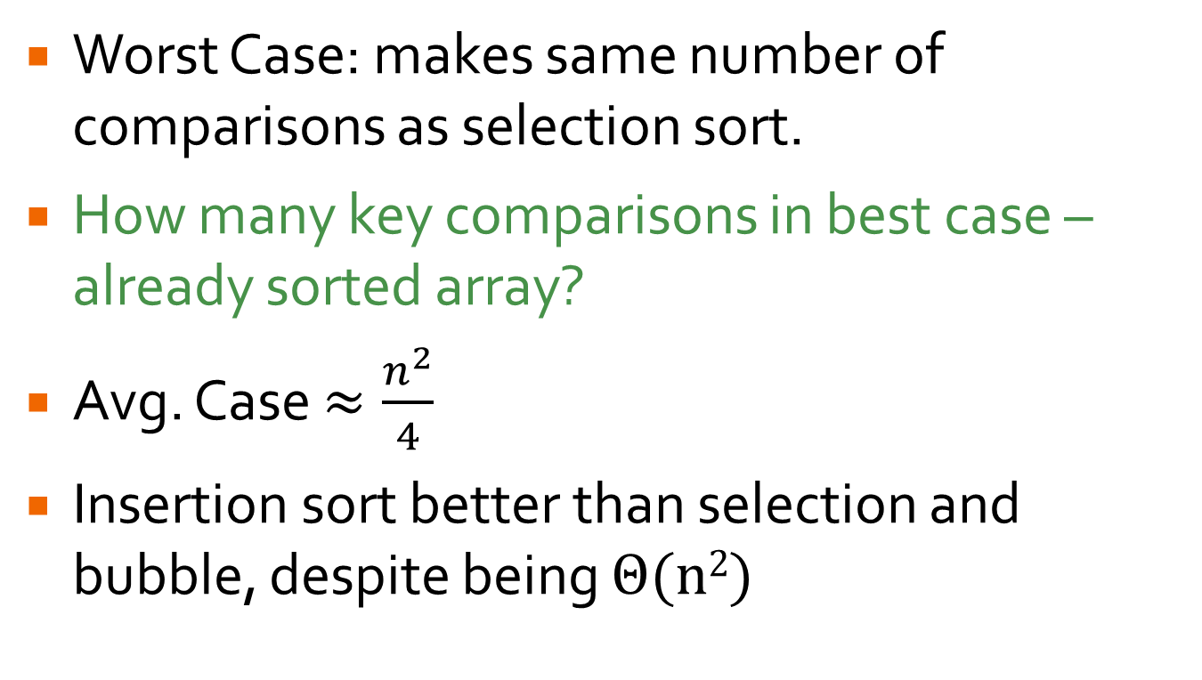
Insertion Sort Efficiency
Worst Case: makes same number of comparisons as selection sort.
How many key comparisons in best case – already sorted array?
Avg. Case $≈\frac{n^{2}}{4}$
Insertion sort better than selection and bubble, despite being Θ(n²)

Slide 13
Topological Sorting

Slide 14
Topological Sorting
Topological Sorting: List all of the vertices from a digraph in such an order that for every edge in the graph, the vertex where edge starts is listed before vertex where it ends.
COMP 51
COMP 157
COMP 147
COMP 47
COMP 53
COMP 127

Slide 15
Topological Sorting
Topological Sorting Uses:
Scheduling
Pre-req checking
Instruction Scheduling in Compiling
Resolving Symbol Dependencies in Linking
Cell Evaluation Order in Spreadsheets
Only possible if digraph is a dag.

Slide 16
DFS Traversal
If encounter a back-edge, not a dag
Otherwise, note order that vertices are popped off stack
Reverse of this order is topological sort
COMP 51
COMP 157
COMP 147
COMP 47
COMP 53
COMP 127

Slide 17
Reference: DFS Algorithm
# Stack Structure Implicit: Uses Call Stack
count ← 0 // global var
DFS(G)
// Input: graph G = <V,E>
mark each vertex in V with 0 // unvisited
for each vertex v in V do
if v is marked with 0
dfs(v)
dfs(v)
count ← count + 1
mark v with count
for each vertex w adjacent to v do
if w is marked with 0
dfs(w)

Slide 18
DFS Traversal
Pop Order:
COMP 51
COMP 157
COMP 147
COMP 47
COMP 53
COMP 51
COMP 127

Slide 19
DFS Traversal
Pop Order:
COMP 51
COMP 157
COMP 147
COMP 53
COMP 47
COMP 53
COMP 51
COMP 127

Slide 20
DFS Traversal
Pop Order:
COMP 51
COMP 157
COMP 147
COMP 127
COMP 53
COMP 47
COMP 53
COMP 51
COMP 127

Slide 21
DFS Traversal
Pop Order: 127
COMP 127
COMP 51
COMP 157
COMP 147
COMP 53
COMP 47
COMP 53
COMP 51
COMP 127

Slide 22
DFS Traversal
Pop Order: 127
COMP 51
COMP 157
COMP 147
COMP 53
COMP 47
COMP 53
COMP 51
COMP 127

Slide 23
DFS Traversal
Pop Order: 127
COMP 51
COMP 157
COMP 147
COMP 147
COMP 53
COMP 47
COMP 53
COMP 51
COMP 127

Slide 24
DFS Traversal
Pop Order: 147 → 127
COMP 147
COMP 51
COMP 157
COMP 147
COMP 53
COMP 47
COMP 53
COMP 51
COMP 127

Slide 25
DFS Traversal
Pop Order: 147 → 127
COMP 51
COMP 157
COMP 147
COMP 53
COMP 47
COMP 53
COMP 51
COMP 127

Slide 26
DFS Traversal
Pop Order: 147 → 127
COMP 51
COMP 157
COMP 147
COMP 157
COMP 53
COMP 47
COMP 53
COMP 51
COMP 127

Slide 27
DFS Traversal
Pop Order: 157 → 147 → 127
COMP 157
COMP 51
COMP 157
COMP 147
COMP 53
COMP 47
COMP 53
COMP 51
COMP 127

Slide 28
DFS Traversal
Pop Order: 157 → 147 → 127
COMP 51
COMP 157
COMP 147
COMP 53
COMP 47
COMP 53
COMP 51
COMP 127

Slide 29
DFS Traversal
Pop Order: 53 → 157 → 147 → 127
COMP 53
COMP 51
COMP 157
COMP 147
COMP 47
COMP 53
COMP 51
COMP 127

Slide 30
DFS Traversal
Pop Order: 53 → 157 → 147 → 127
COMP 51
COMP 157
COMP 147
COMP 47
COMP 53
COMP 51
COMP 127

Slide 31
DFS Traversal
Pop Order: 51 → 53 → 157 → 147 → 127
COMP 51
COMP 157
COMP 147
COMP 51
COMP 47
COMP 53
COMP 127

Slide 32
DFS Traversal
Pop Order: 51 → 53 → 157 → 147 → 127
COMP 51
COMP 157
COMP 147
COMP 47
COMP 53
COMP 47
COMP 127

Slide 33
DFS Traversal
Pop Order: 47 → 51 → 53 → 157 → 147 → 127
COMP 51
COMP 157
COMP 147
COMP 47
COMP 47
COMP 53
COMP 127

Slide 34
DFS Traversal
Soln: 47 → 51 → 53 → 157 → 147 → 127
COMP 47
COMP 51
COMP 53
COMP 157
COMP 147
COMP 127

Slide 35
Source-Removal: Decrease-By-1
Each iteration:
Identify a source – a vertex with no incoming edges. Any sources?
If no sources, not a dag
Remove source and all outgoing edges
COMP 51
COMP 157
COMP 147
COMP 47
COMP 53
COMP 127

Slide 36
Source-Removal: Decrease-By-1
Removed: 51
COMP 51
COMP 157
COMP 147
COMP 47
COMP 53
COMP 127

Slide 37
Source-Removal: Decrease-By-1
Removed: 51 → 47
COMP 157
COMP 147
COMP 47
COMP 53
COMP 127

Slide 38
Source-Removal: Decrease-By-1
Removed: 51 → 47 → 53
COMP 157
COMP 147
COMP 53
COMP 127

Slide 39
Source-Removal: Decrease-By-1
Removed: 51 → 47 → 53 → 127
COMP 157
COMP 147
COMP 127

Slide 40
Source-Removal: Decrease-By-1
Removed: 51 → 47 → 53 → 127 → 147
COMP 157
COMP 147

Slide 41
Source-Removal: Decrease-By-1
Removed: 51 → 47 → 53 → 127 → 147 → 157
COMP 157

Slide 42
Generating Combinatorial Objects

Slide 43
Generating Permutations
Assume have a set of n integers from 1…n
Could generalize by assuming integers are indices of n element set.
Decrease-by-1: assume generated all permutations of set 1…n-1.
How can we get the permutations of 1…n?

Slide 44
Permutations Example
1 | 2
2 | 1
3
1 | 2
3
2 | 1
1 | 2
3
2 | 1
3
1 | 2
3
2 | 1
3

Slide 45
Minimal Change
Filling from right-to-left, then left-to-right, then …
Minimal Change: Each adjacent permutation only differs by two adjacent values being swapped.
Algorithm Speed
Often useful in applications

Slide 46
Example
Start with 1
2 into 1, r to l
3 into 12, r to l
3 into 21, l to r
4 into 123, r to l
4 into 132, l to r
4 into 312, r to l
4 into 321, l to r
4 into 231, r to l
4 into 213, l to r
...
1
12 21
123 132 312
321 231 213
1234 1243 1423 4123
4132 1432 1342 1324
3124 3142 3412 4312
4321 3421 3241 3214
2314 2341 2431 4231
4213 2413 2143 2134
...

Slide 47
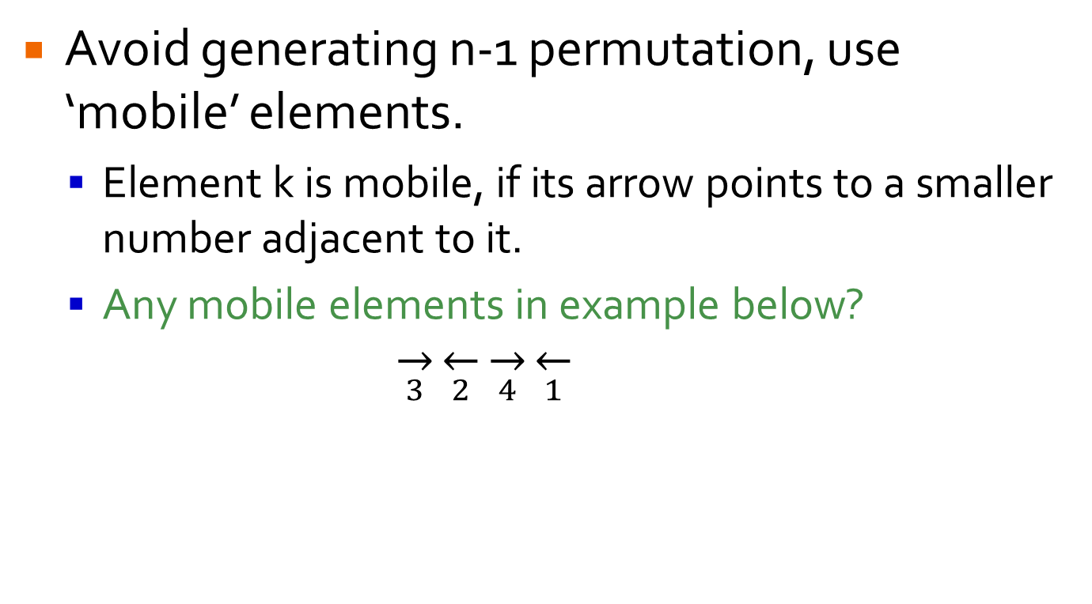
Johnson-Trotter
Avoid generating n-1 permutation, use ‘mobile’ elements.
Element k is mobile, if its arrow points to a smaller number adjacent to it.
Any mobile elements in example below? $\overset{→}{3}\overset{←}{2}\overset{→}{4}\overset{←}{1}$

Slide 48
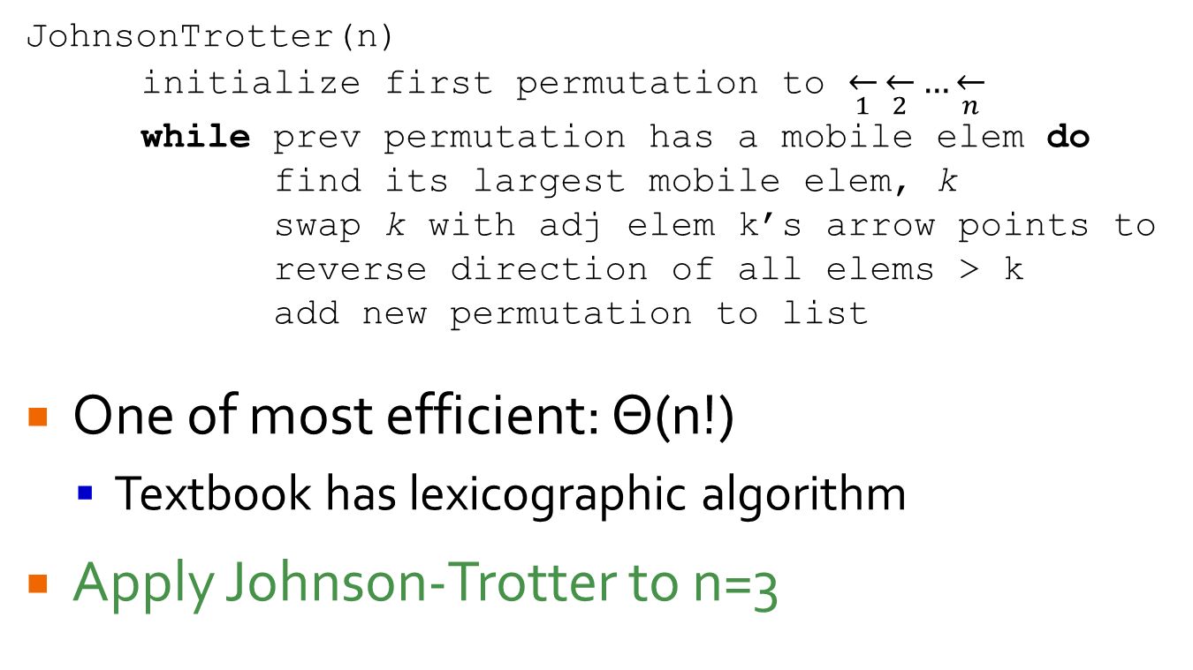
Johnson-Trotter
JohnsonTrotter(n)
initialize first permutation to $\overset{←}{1}\overset{←}{2}…\overset{←}{n}$
while prev permutation has a mobile elem do
find its largest mobile elem, k
swap k with adj elem k’s arrow points to
reverse direction of all elems > k
add new permutation to list
One of most efficient: Θ(n!)
Textbook has lexicographic algorithm
Apply Johnson-Trotter to n=3

Slide 49
Generating Subsets
Set: {e₂,e₅,e₇}
Involves generating all bit-strings of length n (with leading 0’s)
Generate all sets produced by length 3 bit strings
e₁ | e₂ | e₃ | e₄ | e₅ | e₆ | e₇ | e₈ | e₉ | e₁₀
0 | 1 | 0 | 0 | 1 | 0 | 1 | 0 | 0 | 0

Slide 50
Generating Subsets
Involves generating all bit-strings of length n (with leading 0’s)
Generate all sets produced by length 3 bit strings
Need Gray code binary representation for minimal change sets.
000 | 001 | 010 | 011 | 100 | 101 | 110 | 111
{} | {e₃} | {e₂} | {e₂,e₃} | {e₁} | {e₁,e₃} | {e₁,e₂} | {e₁,e₂,e₃}

Slide 51
Gray Code Representation
Need Gray code binary representation for minimal change sets
000 | 001 | 011 | 010 | 110 | 111 | 101 | 100
{} | {e₃} | {e₂,e₃} | {e₂} | {e₁,e₂} | {e₁,e₂,e₃} | {e₁,e₃} | {e₁}

Slide 52
Generating Gray Codes
BRGC(n)
if n = 1
L ← {0, 1}
else
L1 ← BRGC(n-1)
L2 ← reverse of L1
add 0 in front of each elem in L1
add 1 in front of each elem in L2
L ← L2 appended to L1
return L

